Slide 1



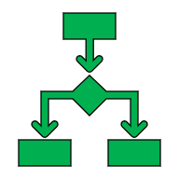
Dialog Tree Class Diagram
NPC Content
DialogTree
Props: Name,
Methods: Node Creation Methods, integration with Unity Editor
DialogNode
Dialog
Choices
Props: Conditions (for allowing choice), List Events
DialogEvents

Slide 2

Dialog Tree Structure
Dialog
Choices
DialogNode
Start/Trigger
Dialog
Choices
Dialog
Choices
DialogNode
DialogNode
End
Dialog
Choices
Dialog
Choices

Slide 3






Dialog System
Player Controller
Input
DialogTrigger.cs
“e” , Spotlight, proximity
NPCContent
DialogTree
(Inventory)
DialogManager
DialogNavigator

Slide 4
“Whiteboarding Practice: Palindrome?
Word the same forward and back. Does not include spaces. Capital case matches lower case.
Bool IsPalindrome(String Input)
// double pointer
For (int I = 0, I = input.length/2, i++)
If
(!input[i] = input[length-i-1])
return false
Return true
Test Cases:
Hello World!
Racecar
Tsunami

